Slide 1
CNA 465/565
Chapter 5
Overview of Wireless Communications

Slide 2
Spectrum considerations
Controlled by regulatory bodies
  Carrier frequency
  Signal Power
  Multiple Access Scheme
    Divide into time slots –Time Division Multiple Access (TDMA)
    Divide into frequency bands – Frequency Division Multiple Access (FDMA)
    Different signal encodings – Code Division Multiple Access (CDMA)

Slide 3
Spectrum considerations
Federal Communications Commission (FCC) in the United States regulates spectrum
  Military
  Broadcasting
  Public Safety
  Mobile
  Amateur
  Government exclusive, non-government exclusive, or both
  Many other categories

Slide 4
Spectrum considerations
Industrial, Scientific, and Medical (ISM) bands
  Can be used without a license
  As long as power and spread spectrum regulations are followed
ISM bands are used for
  WLANs
  Wireless Personal Area networks
  Internet of Things

Slide 5
Propagation Modes
Ground-wave propagation
Sky-wave propagation
Line-of-sight propagation

Slide 6
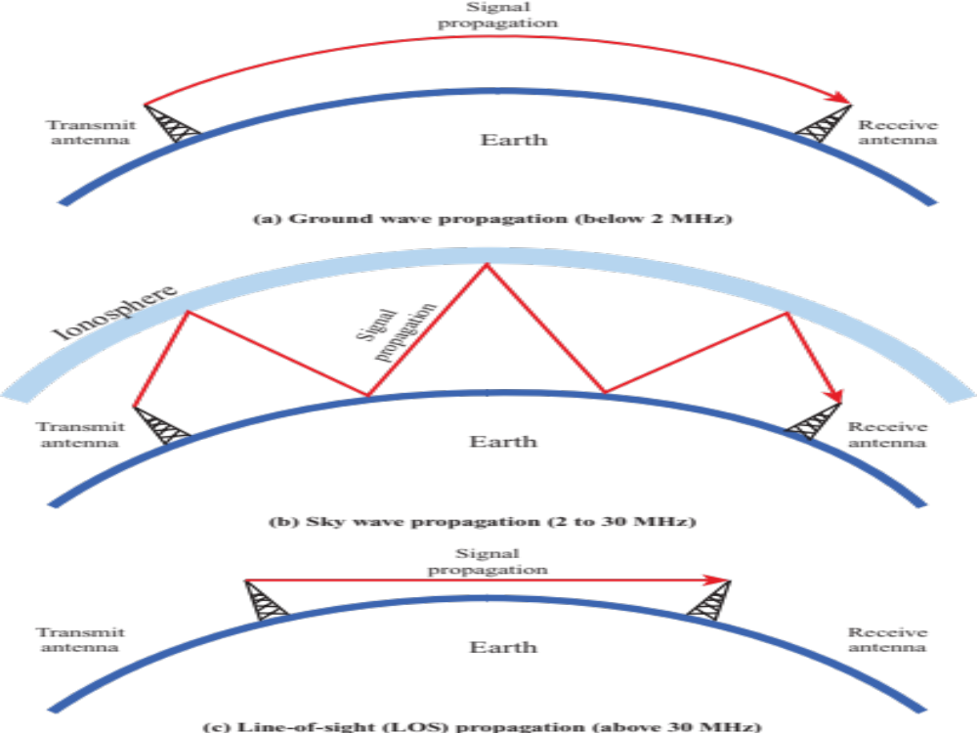
5.1 Wireless Propagation Modes

Slide 7
Ground Wave Propagation
Follows contour of the earth
Can propagate considerable distances
Frequencies up to 2 MHz
Example
  AM radio

Slide 8
Sky Wave Propagation
Signal reflected from ionized layer of atmosphere back down to earth
Signal can travel a number of hops, back and forth between ionosphere and earth’s surface
Reflection effect caused by refraction
Examples
  Amateur radio
  CB radio

Slide 9
Line-of-Sight Propagation
Transmitting and receiving antennas must be within line of sight
  Satellite communication – signal above 30 MHz not reflected by ionosphere
  Ground communication – antennas within effective line of site due to refraction
Refraction – bending of microwaves by the atmosphere
  Velocity of electromagnetic wave is a function of the density of the medium
  When wave changes medium, speed changes
  Wave bends at the boundary between mediums

Slide 10
Five basic propagation mechanisms
Free-space propagation
Transmission
  Through a medium
  Refraction occurs at boundaries
Reflections
  Waves impinge upon surfaces that are large compared to the signal wavelength
Diffraction
  Secondary waves behind objects with sharp edges
Scattering
  Interactions between small objects or rough surfaces

Slide 11
antennas
An antenna is an electrical conductor or system of conductors
  Transmission - radiates electromagnetic energy into space
  Reception - collects electromagnetic energy from space
In two-way communication, the same antenna can be used for transmission and reception

Slide 12
Radiation Patterns
Radiation pattern
  Graphical representation of radiation properties of an antenna
  Depicted as two-dimensional cross section
Beam width (or half-power beam width)
  Measure of directivity of antenna
Reception pattern
  Receiving antenna’s equivalent to radiation pattern
Sidelobes
  Extra energy in directions outside the mainlobe
Nulls
  Very low energy in between mainlobe and sidelobes

Slide 13
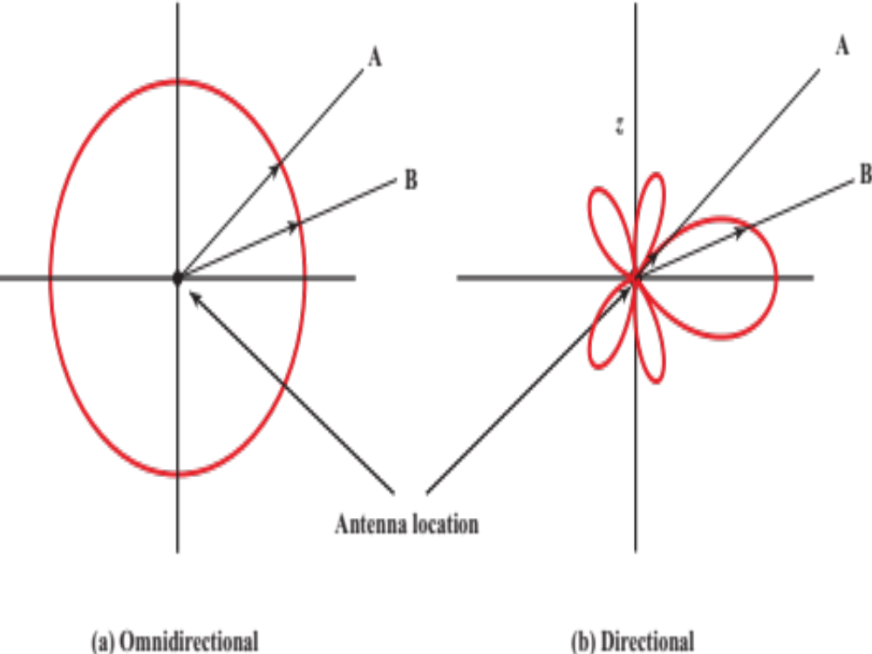
5.2 Antenna Radiation Patterns

Slide 14
Attenuation
Strength of signal falls off with distance over transmission medium
Attenuation factors for unguided media:
  Received signal must have sufficient strength so that circuitry in the receiver can interpret the signal
  Signal must maintain a level sufficiently higher than noise to be received without error
  Attenuation is greater at higher frequencies, causing distortion

Slide 15
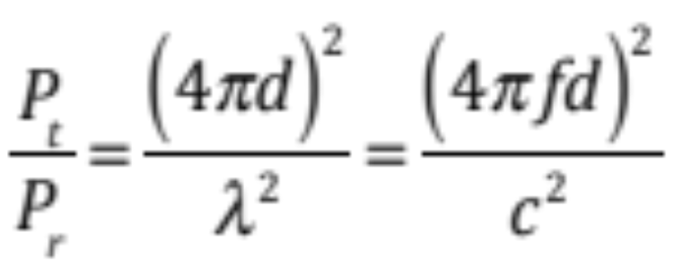
Free Space Loss
Free space loss, ideal isotropic antenna
    P_{t} = signal power at transmitting antenna
    P_{r} = signal power at receiving antenna
    λ = carrier wavelength
    d = propagation distance between antennas
    c = speed of light (3 ×10⁸ m/s)
    where d and λ are in the same units (e.g., meters)

Slide 16
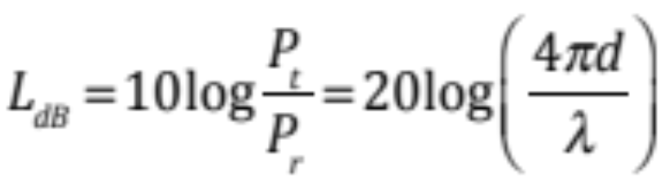
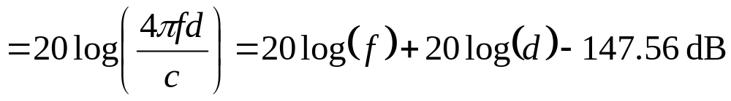
Free Space Loss
Free space loss equation can be recast:

Slide 17
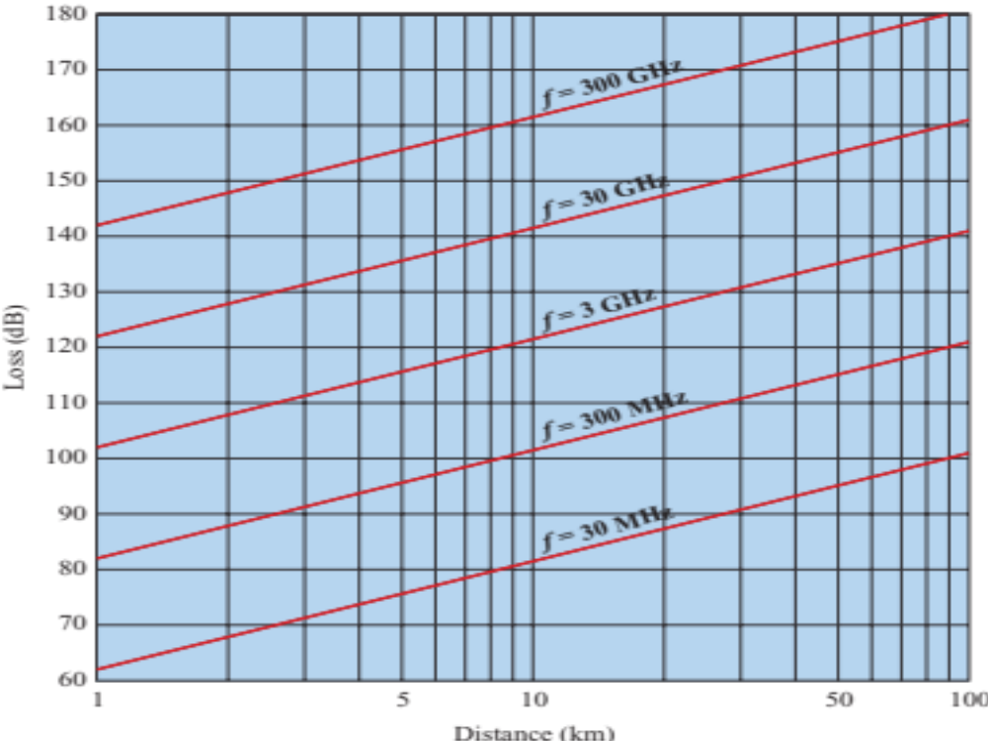
5.3 Free Space Loss

Slide 18
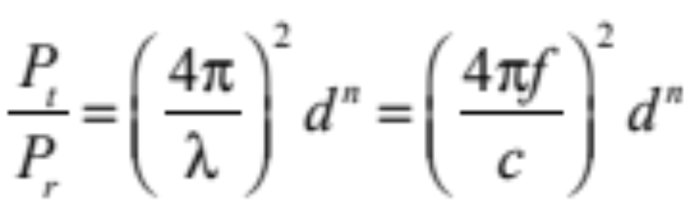
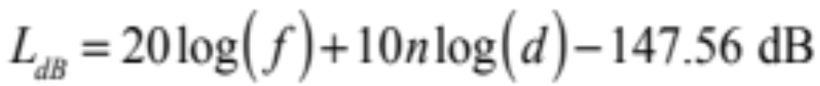
Path Loss Exponent in practical systems
Practical systems – reflections, scattering, etc.
Beyond a certain distance, received power decreases logarithmically with distance
  Based on many measurement studies

Slide 19
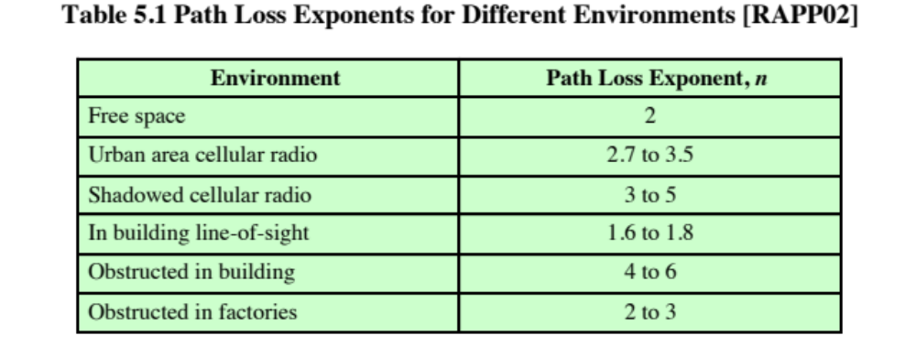
Path Loss Exponent in practical systems

Slide 20
Models Derived from Empirical Measurements
Need to design systems based on empirical data applied to a particular environment
  To determine power levels, tower heights, height of mobile antennas
Okumura developed a model, later refined by Hata
  Detailed measurement and analysis of the Tokyo area
  Among the best accuracy in a wide variety of situations
Predicts path loss for typical environments
  Urban
  Small, medium sized city
  Large city
  Suburban
  Rural

Slide 21
Categories of Noise
Thermal Noise
Intermodulation noise
Crosstalk
Impulse Noise

Slide 22
Thermal Noise
Thermal noise due to agitation of electrons
Present in all electronic devices and transmission media
Cannot be eliminated
Function of temperature
Particularly significant for satellite communication

Slide 23
Noise Terminology
Intermodulation noise – occurs if signals with different frequencies share the same medium
  Interference caused by a signal produced at a frequency that is the sum or difference of original frequencies
Crosstalk – unwanted coupling between signal paths
Impulse noise – irregular pulses or noise spikes
  Short duration and of relatively high amplitude
  Caused by external electromagnetic disturbances, or faults and flaws in the communications system

Slide 24
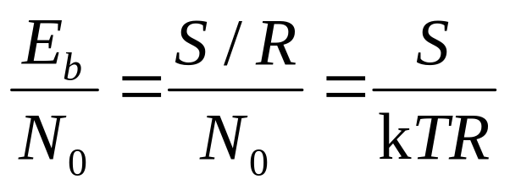
EXPRESSION E_{b}/N₀
Ratio of signal energy per bit to noise power density per Hertz
The bit error rate (i.e., bit error probability) for digital data is a function of E_{b}/N₀
  Given a value for E_{b}/N₀ to achieve a desired error rate, parameters of this formula can be selected
  As bit rate R increases, transmitted signal power must increase to maintain required E_{b}/N₀

Slide 25
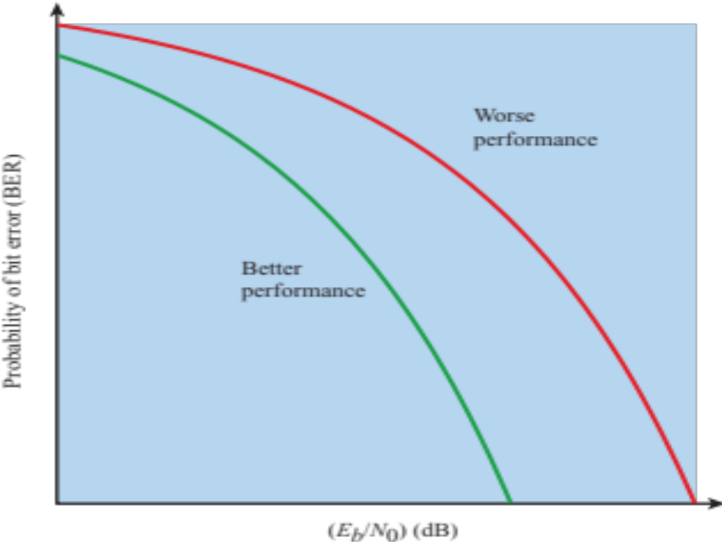
5.4 GENERAL SHAPE OF BER VERSUS E_{b}/N₀ CURVES

Slide 26
Other Impairments
Atmospheric absorption – water vapor and oxygen contribute to attenuation
Multipath – obstacles reflect signals so that multiple copies with varying delays are received
Refraction – bending of radio waves as they propagate through the atmosphere

Slide 27
The Effects of Multipath Propagation
Reflection, diffraction, and scattering
Multiple copies of a signal may arrive at different phases
  If phases add destructively, the signal level relative to noise declines, making detection more difficult
Intersymbol interference (ISI)
  One or more delayed copies of a pulse may arrive at the same time as the primary pulse for a subsequent bit
Rapid signal fluctuations
  Over a few centimeters

Slide 28
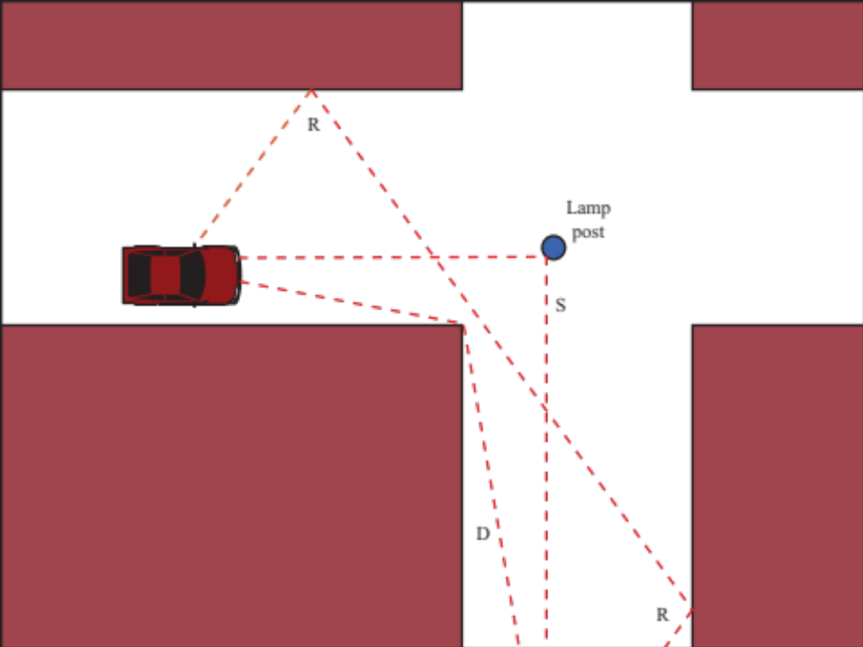
5.5 Sketch of Three Important Propagation Mechanisms

Slide 29
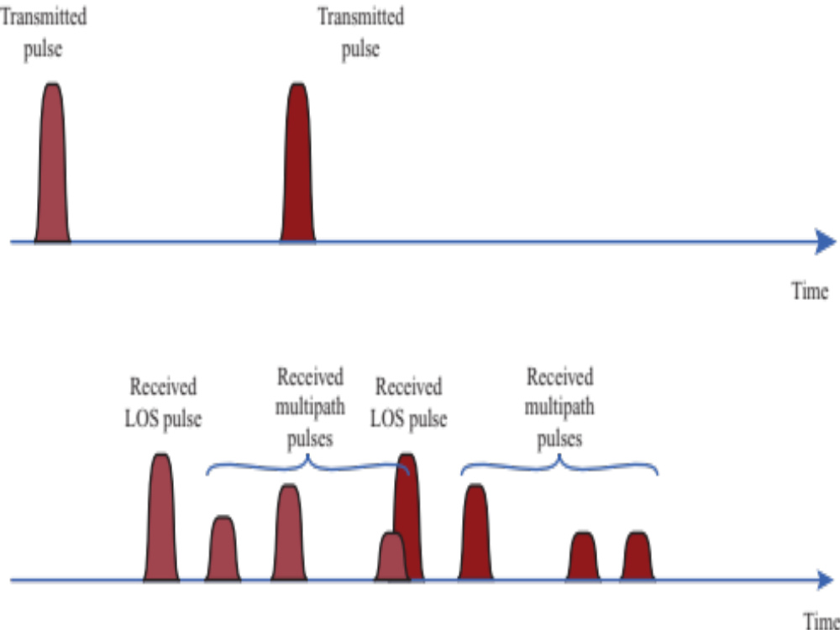
5.6 Two Pulses in Time-Variant Multipath

Slide 30
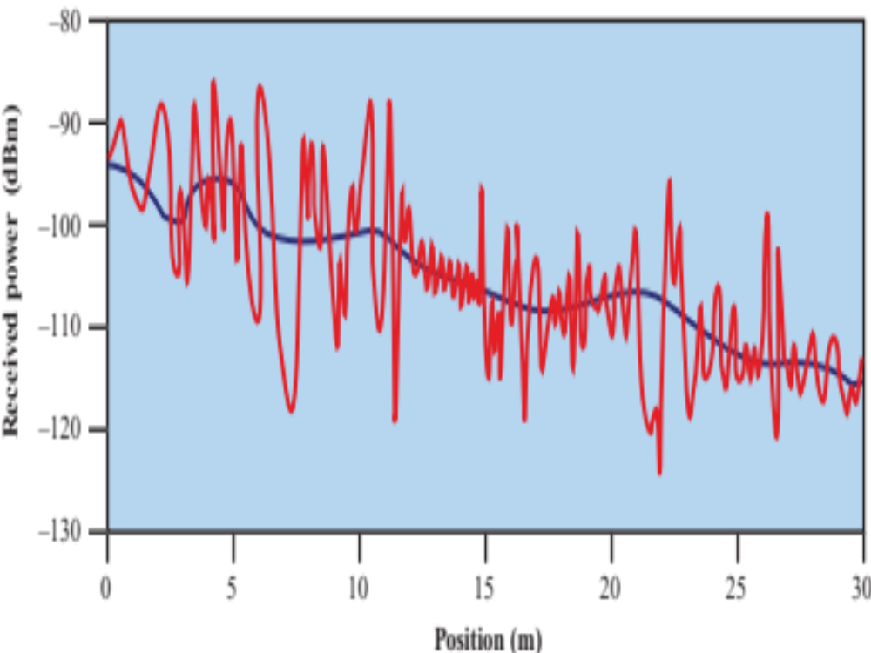
5.7 Typical Large-Scale and Small-Scale Fading in an Urban Mobile Environment

Slide 31
Types of Fading
Large-scale fading
  Signal variations over large distances
  Path loss L_{dB} as we have seen already
  Shadowing
Statistical variations
  Rayleigh fading
  Ricean fading

Slide 32
Types of fading
Doppler Spread
  Frequency fluctuations caused by movement
  Coherence time T_{c} characterizes Doppler shift
    How long a channel remains the same
  Coherence time T_{c} >> T_{b} bit time → slow fading
    The channel does not change during the bit time
  Otherwise fast fading
Example 6.11: T_{c} = 70 ms, bit rate r_{b} = 100 kbs
  Bit time T_{b} = 1/100 × 10³ = 10 μs
  T_{c} >> T_{b}? 70 ms >> 10 μs?
  True, so slow fading

Slide 33
Types of fading
Multipath fading
  Multiple signals arrive at the receiver
  Coherence bandwidth B_{c} characterizes multipath
    Bandwidth over which the channel response remains relatively constant
    Related to delay spread, the spread in time of the arrivals of multipath signals
  Signal bandwidth B_{s} is proportional to the bit rate
  If B_{c} >> B_{s}, then flat fading
    The signal bandwidth fits well within the channel bandwidth
  Otherwise, frequency selective fading
Example 6.11: B_{c} = 150 kHz, bit rate r_{b} = 100 kbs
  Assume signal bandwidth B_{s} ≈ r_{b}, B_{s} = 100 kHz
  B_{c} >> B_{s}? 150 kHz >> 100 kHz?
  Using a factor of 10 for “>>”, 150 kHz is not more than 10 ×100 kHz
  False, so frequency selective fading

Slide 34
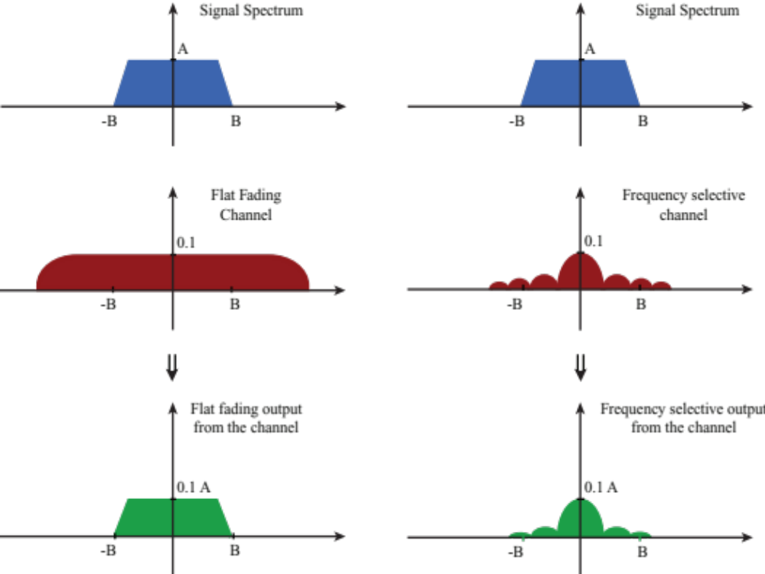
5.8 Flat and Frequency Selective Fading

Slide 35
Channel correction Mechanisms
Forward error correction
Adaptive equalization
Adaptive modulation and coding
Diversity techniques and MIMO
OFDM
Spread sprectrum
Bandwidth expansion

Slide 36
Forward Error Correction
Transmitter adds error-correcting code to data block
  Code is a function of the data bits
Receiver calculates error-correcting code from incoming data bits
  If calculated code matches incoming code, no error occurred
  If error-correcting codes don’t match, receiver attempts to determine bits in error and correct
Subject of Chapter 10

Slide 37
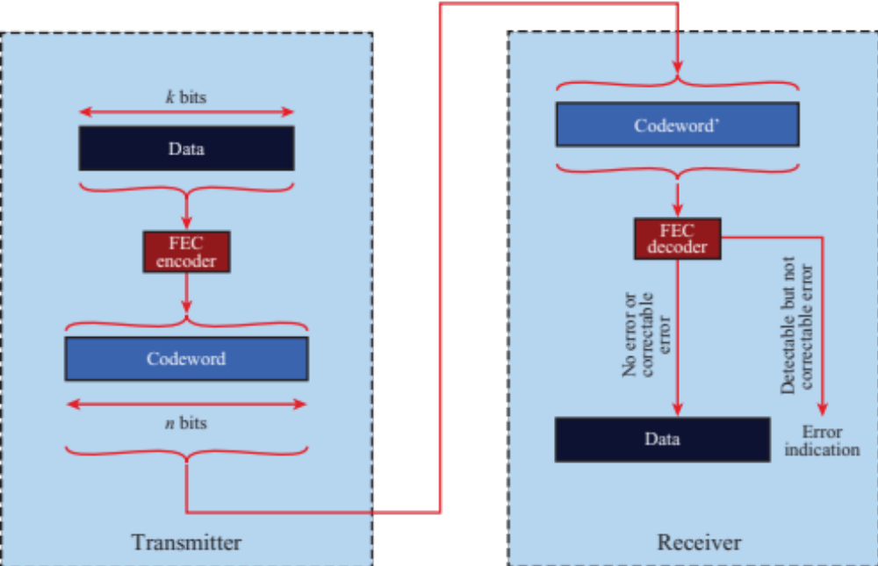
5.15 Forward Error Correction Process

Slide 38
Adaptive Equalization
Can be applied to transmissions that carry analog or digital information
  Analog voice or video
  Digital data, digitized voice or video
Used to combat intersymbol interference
Involves gathering dispersed symbol energy back into its original time interval
Techniques
  Lumped analog circuits
  Sophisticated digital signal processing algorithms

Slide 39
Diversity Techniques
Diversity is based on the fact that individual channels experience independent fading events
Space diversity – techniques involving physical transmission path, spacing antennas
Frequency diversity – techniques where the signal is spread out over a larger frequency bandwidth or carried on multiple frequency carriers
Time diversity – techniques aimed at spreading the data out over time
Use of diversity
  Selection diversity – select the best signal
  Combining diversity – combine the signals

Slide 40
MULTIPLE INPUT MULTIPLE OUTPUT (MIMO) ANTENNAS
Use antenna arrays for
  Diversity – different signals from different antennas
  Multiple streams – parallel data streams
  Beamforming – directional antennas
  Multi-user MIMO – directional beams to multiple simultaneous users
Modern systems
  4 × 4 (4 transmitter and 4 reciever antennas)
  8 × 8
  Two dimensional arrays of 64 antennas
  Future: Massive MIMO with many more antennas

Slide 41
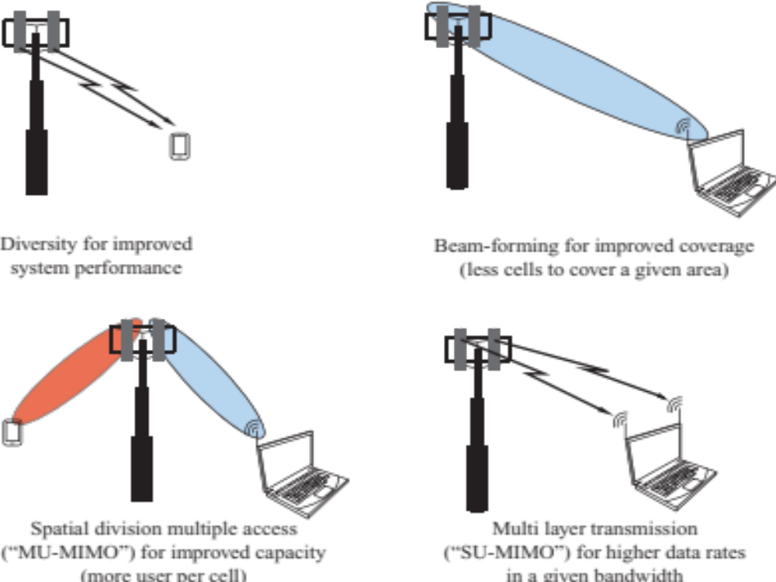
5.9 Four Uses of MIMO

Slide 42
Adaptive modulation and coding (AMC)
The modulation process formats the signal to best transmit bits
  To overcome noise
  To transmit as many bits as possible
Coding detects and corrects errors
AMC adapts to channel conditions
  100’s of times per second
  Measures channel conditions
  Sends messages between transmitter and receiver to coordinate changes

Slide 43
Bandwidth expansion
A signal can only provide a limited bps/Hz
  More bandwidth is needed
Carrier aggregation
  Combine multiple channels
    Example: Fourth-generation LTE combines third-generation carriers
Frequency reuse
  Limit propagation range to an area
  Use the same frequencies again when sufficiently far away
  Use large coverage areas (macro cells) and smaller coverage areas (outdoor picocells or relays and indoor femtocells)
Millimeter wave (mmWave)
  Higher carrier frequencies have more bandwidth available
  30 to 300 GHz bands with millimeter wavelengths
  Yet these are expensive to use and have problems with obstructions

Slide 44
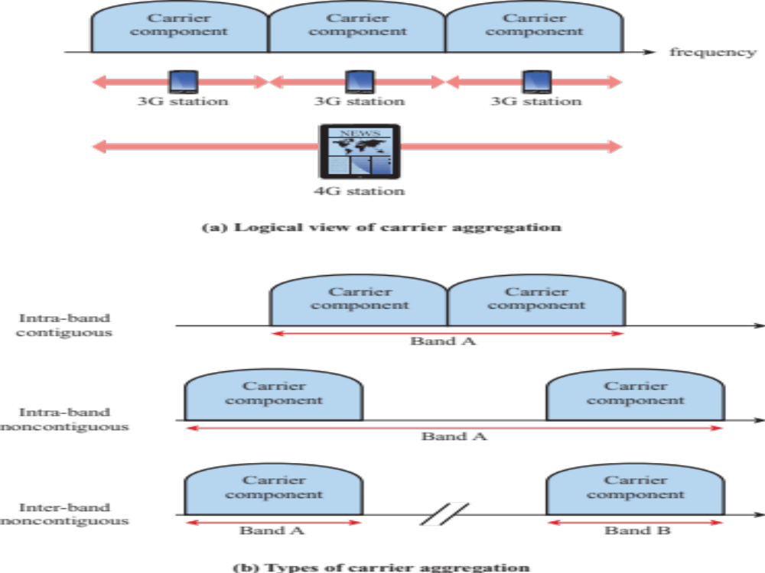
Figure 14.14 LTE Carrier Aggregation

Slide 45
signal Encoding Techniques
Digital data to analog signal
  Amplitude-shift keying (ASK)
    Amplitude difference of carrier frequency
  Frequency-shift keying (FSK)
    Frequency difference near carrier frequency
  Phase-shift keying (PSK)
    Phase of carrier signal shifted

Slide 46
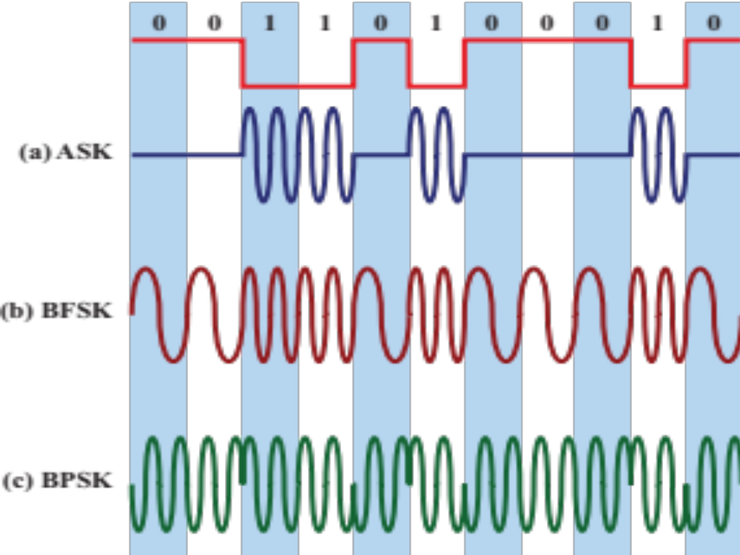
5.10 Modulation of Analog Signals for Digital Data

Slide 47
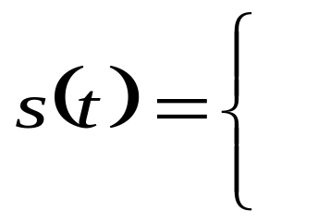
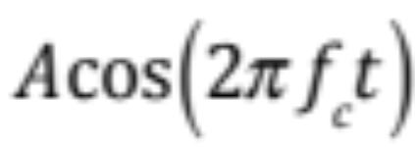
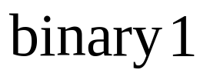

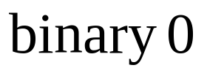
Amplitude-Shift Keying
One binary digit represented by presence of carrier, at constant amplitude
Other binary digit represented by absence of carrier
    where the carrier signal is Acos(2πf_{c}t)

Slide 48
Amplitude-Shift Keying
Susceptible to sudden gain changes
Inefficient modulation technique
Used to transmit digital data over optical fiber

Slide 49
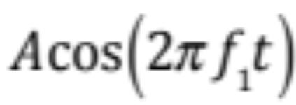

Binary Frequency-Shift Keying (BFSK)
Two binary digits represented by two different frequencies near the carrier frequency
    where f₁ and f₂ are offset from carrier frequency f_{c} by equal but opposite amounts f_{d}

Slide 50
Binary Frequency-Shift Keying (BFSK)
Less susceptible to error than ASK
Used for high-frequency (3 to 30 MHz) radio transmission
Can be used at higher frequencies on LANs that use coaxial cable

Slide 51
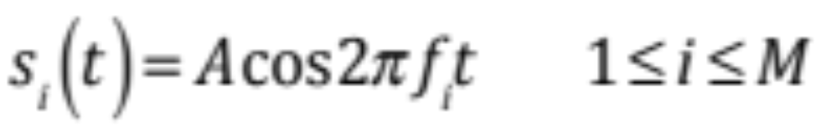
Multiple Frequency-Shift Keying (MFSK)
More than two frequencies are used
More bandwidth efficient but more susceptible to error
    f _{i} = f _{c} + (2i – 1 – M)f _{d}
    f _{c} = the carrier frequency
    f _{d} = the difference frequency
    M = number of different signal elements = 2^{L}
    L = number of bits per signal element

Slide 52
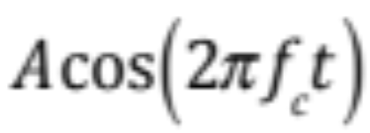
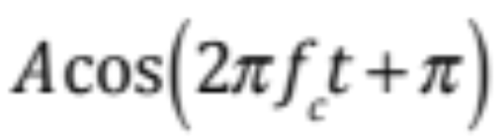
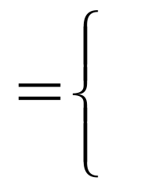
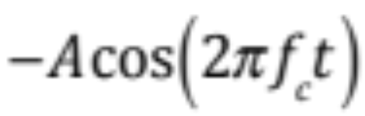
Phase-Shift Keying (PSK)
Two-level PSK (BPSK)
  Uses two phases to represent binary digits

Slide 53
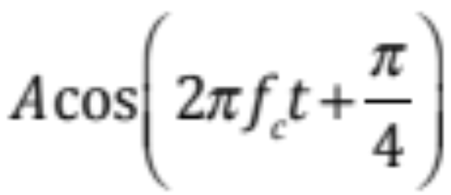
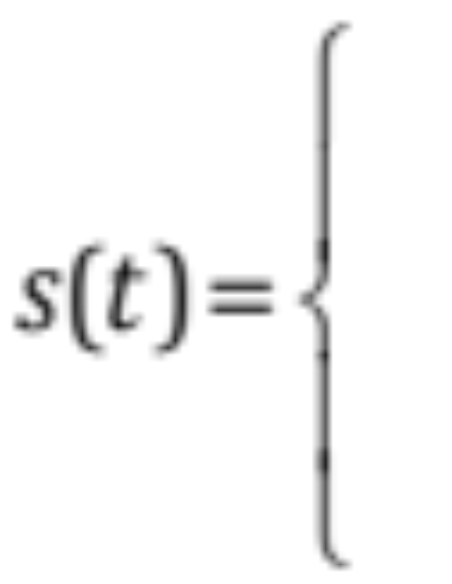

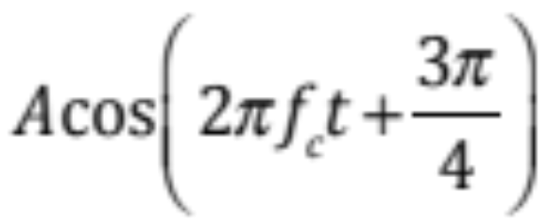

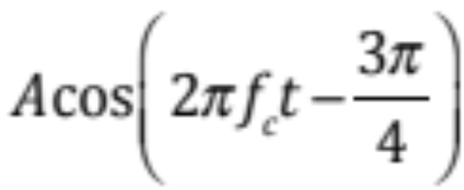

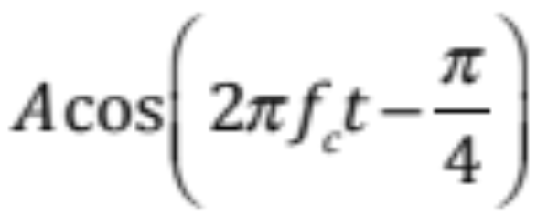

Quadrature Phase-Shift Keying (PSK)
Four-level PSK (QPSK)
  Each element represents more than one bit

Slide 54
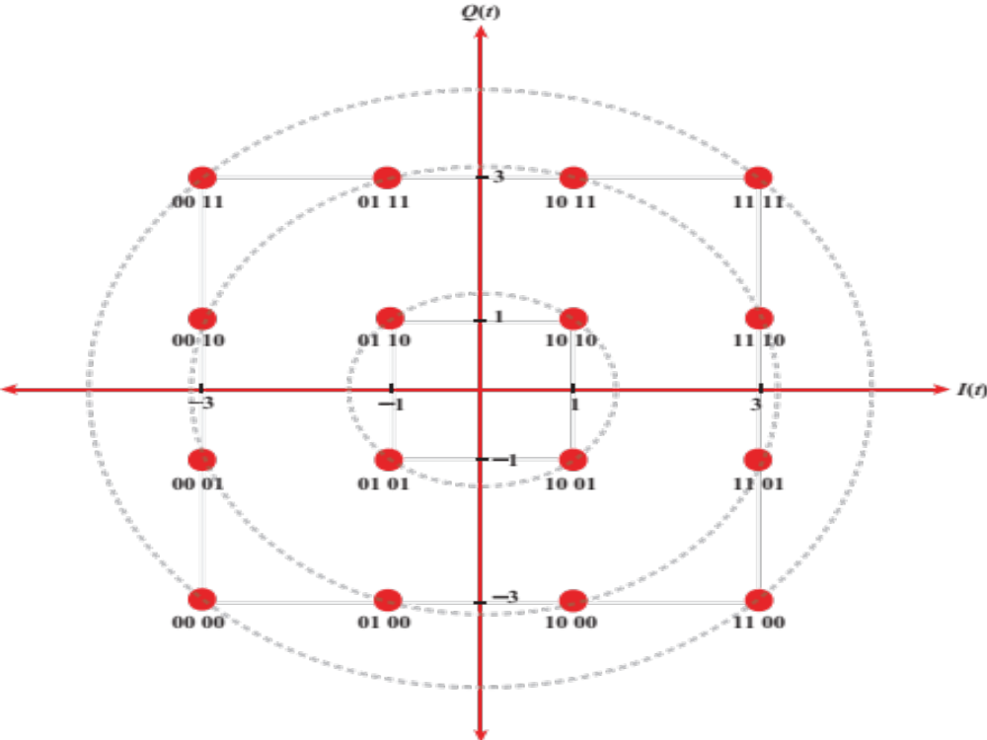
5.11 16QAM Constellation Diagram

Slide 55
Bit Error rate (BER)
Performance must be assessed in the presence of noise
“Bit error probability” is probably a clearer term
  BER is not a rate in bits/sec, but rather a probability
  Commonly plotted on a log scale in the y-axis and E_{b}/N₀ in dB on the x-axis
  As E_{b}/N₀ increases, BER drops
Curves to the lower left have better performance
  Lower BER at the same E_{b}/N₀
  Lower E_{b}/N₀ for the same BER

Slide 56
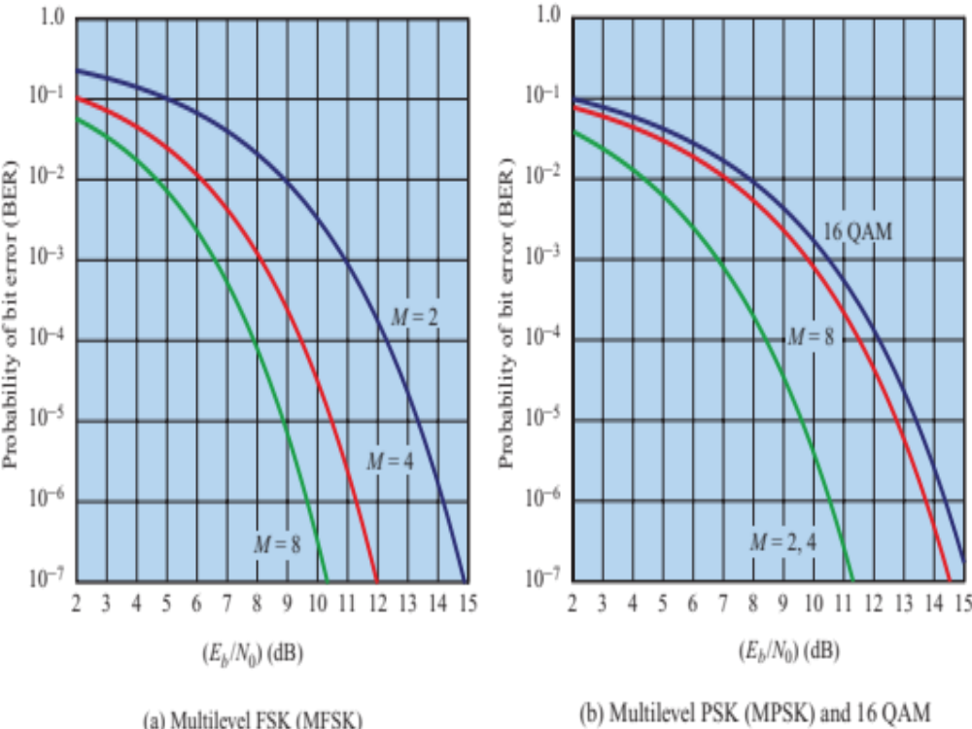
5.12 Theoretical Bit Error Rate for Multilevel FSK, PSK, and QAM

Slide 57
CODING AND ERROR CONTROL
Error detection codes
  Detects the presence of an error
Automatic repeat request (ARQ) protocols
  Block of data with error is discarded
  Transmitter retransmits that block of data
Error correction codes, or forward correction codes (FEC)
  Designed to detect and correct errors

Slide 58
Error Detection Probabilities
Definitions
    P_{b} : Probability of single bit error (BER)
    P₁ : Probability that a frame arrives with no bit errors
    P₂ : While using error detection, the probability that a frame arrives with one or more undetected errors
    P₃ : While using error detection, the probability that a frame arrives with one or more detected bit errors but no undetected bit errors

Slide 59
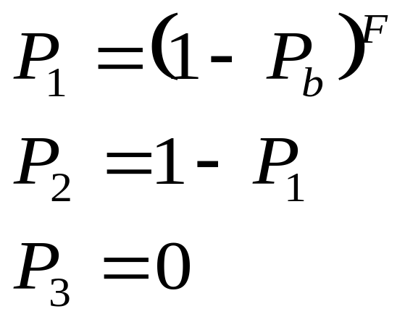
Error Detection Probabilities
With no error detection
    F = Number of bits per frame

Slide 60
Error Detection Process
Transmitter
  For a given frame, an error-detecting code (check bits) is calculated from data bits
  Check bits are appended to data bits
Receiver
  Separates incoming frame into data bits and check bits
  Calculates check bits from received data bits
  Compares calculated check bits against received check bits
  Detected error occurs if mismatch

Slide 61
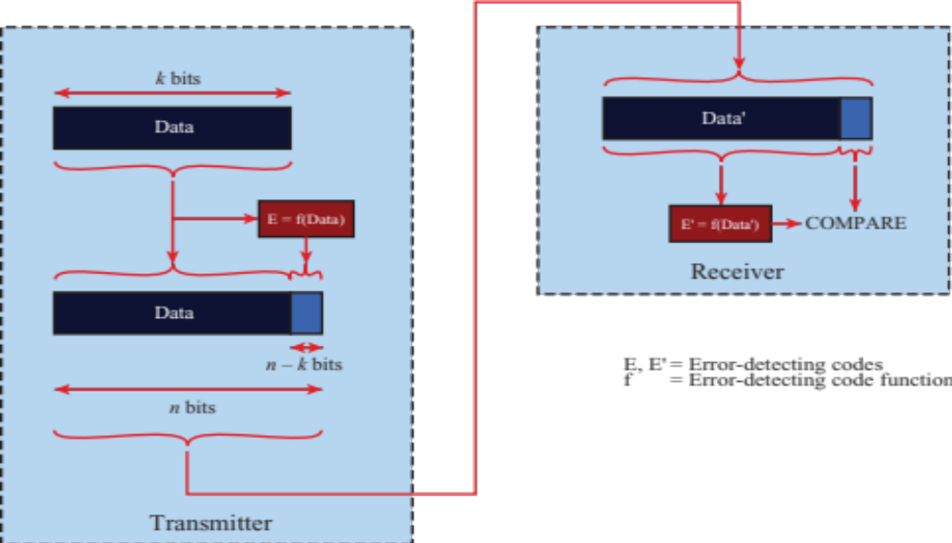
5.13 Error Detection Process

Slide 62
Parity Check
Parity bit appended to a block of data
Even parity
  Added bit ensures an even number of 1s
Odd parity
  Added bit ensures an odd number of 1s
Example, 7-bit character [1110001]
  Even parity [11100010]
  Odd parity [11100011]

Slide 63
Cyclic Redundancy Check (CRC)
Transmitter
  For a k-bit block, transmitter generates an (n-k)-bit frame check sequence (FCS)
  Resulting frame of n bits is exactly divisible by predetermined number
Receiver
  Divides incoming frame by predetermined number
  If no remainder, assumes no error

Slide 64
CRC using Modulo 2 Arithmetic
Exclusive-OR (XOR) operation
Parameters:
    T = n-bit frame to be transmitted
    D = k-bit block of data; the first k bits of T
    F = (n – k)-bit FCS; the last (n – k) bits of T
    P = pattern of n–k+1 bits; this is the predetermined divisor
    Q = Quotient
    R = Remainder

Slide 65
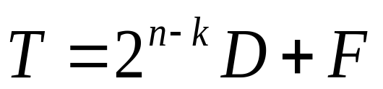
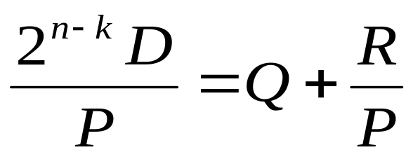
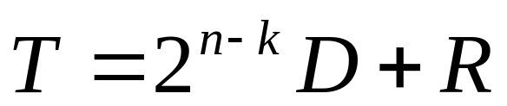
CRC using Modulo 2 Arithmetic
For T/P to have no remainder, start with
Divide 2^{n-k}D by P gives quotient and remainder
Use remainder as FCS

Slide 66
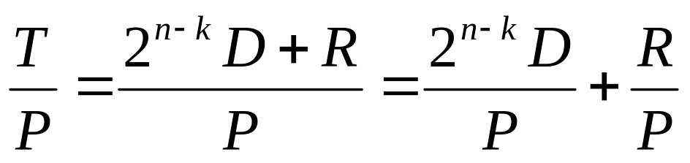
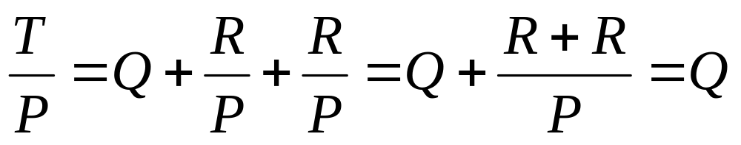
CRC using Modulo 2 Arithmetic
Does R cause T/P have no remainder?
Substituting,
  No remainder, so T is exactly divisible by P

Slide 67
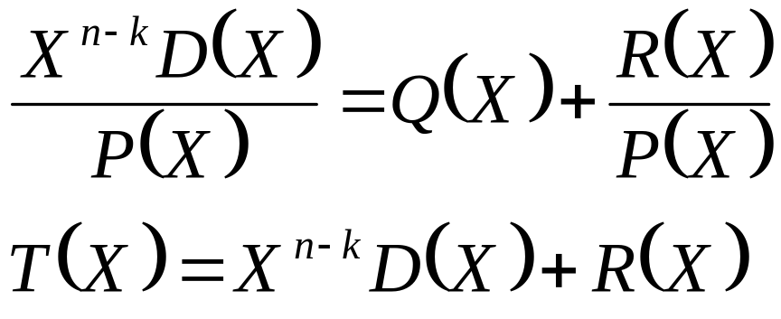
CRC using Polynomials
All values expressed as polynomials
  Dummy variable X with binary coefficients

Slide 68
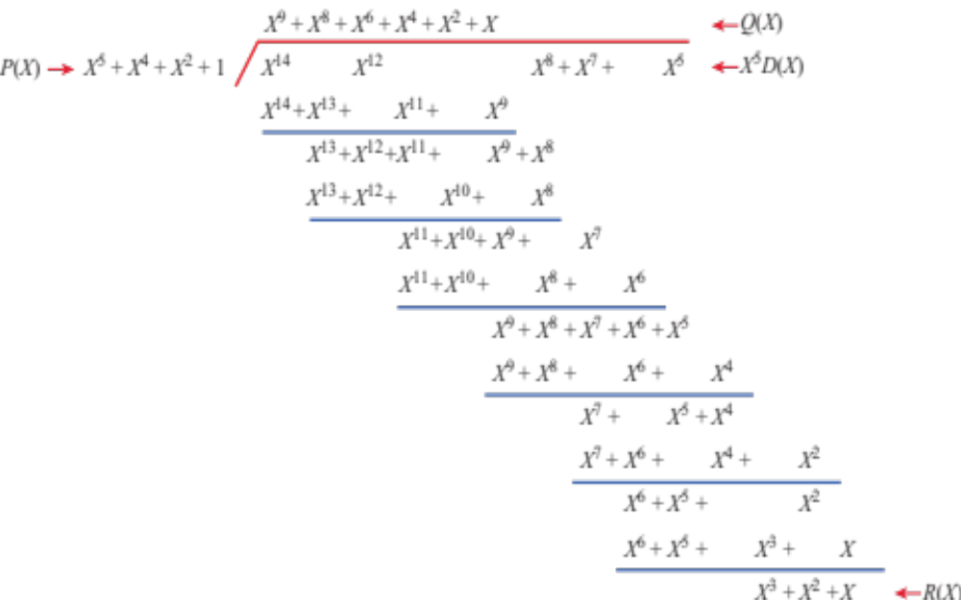
5.14 Polynomial Division for Example 5.10

Slide 69
CRC using Polynomials
Widely used versions of P(X)
  CRC–12
    X¹² + X¹¹ + X³ + X² + X + 1
  CRC–16
    X¹⁶ + X¹⁵ + X² + 1
  CRC – CCITT
    X¹⁶ + X¹² + X⁵ + 1
  CRC – 32
    X³² + X²⁶ + X²³ + X²² + X¹⁶ + X¹² + X¹¹ + X¹⁰ + X⁸ + X⁷ + X⁵ + X⁴ + X² + X + 1

Slide 70
Wireless Transmission Errors
Error detection requires retransmission
Detection inadequate for wireless applications
  Error rate on wireless link can be high, results in a large number of retransmissions
  Long propagation delay compared to transmission time

Slide 71
Block Error Correction Codes
Transmitter
  Forward error correction (FEC) encoder maps each k-bit block into an n-bit block codeword
  Codeword is transmitted; analog for wireless transmission
Receiver
  Incoming signal is demodulated
  Block passed through an FEC decoder

Slide 72
5.15 Forward Error Correction Process

Slide 73
FEC Decoder Outcomes
No errors present
  Codeword produced by decoder matches original codeword
Decoder detects and corrects bit errors
Decoder detects but cannot correct bit errors; reports uncorrectable error
Decoder incorrectly corrects bit errors
  Error pattern looks like a different block of data was sent
Decoder detects no bit errors, though errors are present

Slide 74
Block Code Principles
Hamming distance – for 2 n-bit binary sequences, the number of different bits
  E.g., v₁=011011; v₂=110001; d(v1, v₂)=3
Redundancy – ratio of redundant bits to data bits
Code rate – ratio of data bits to total bits
Coding gain – the reduction in the required E_{b}/N₀ to achieve a specified BER of an error-correcting coded system

Slide 75
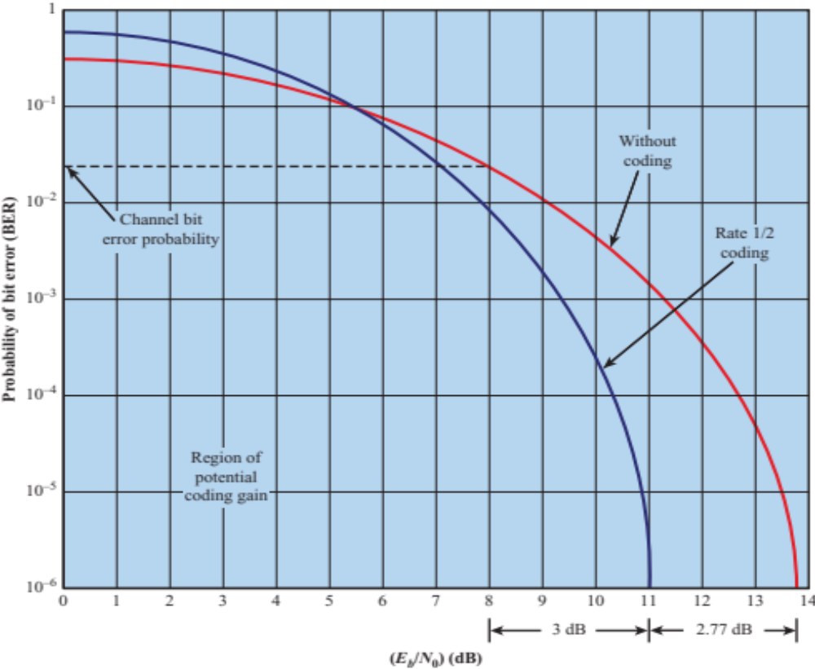
5.16 How Coding Improves System Performance

Slide 76

Decoding process
Coding table
Received: 00100
  Not valid, error is detected
  Correction?
    One bit away from 00000
    Two bits away from 00111
    Three bits away from 11110
    Four bits away from 11110
  Most likely 00000 was sent, assume data was 00
    But others could have been sent, albeit much less likely

Slide 77
Decoding process
Received: 01100
  Two bits from 00000
  Two bits from 11110
  No other codes closer
  Cannot decode. Only know bit errors are detected

Slide 78
Low density parity check (LDPC) codes
Approach Shannon’s limit
  Use very long codes
  Check for errors by using many equations that each add at least three bits together
  Variable nodes correspond to bits
  Constraint nodes implement equations
Uses iterative decoding
  Variable nodes estimate the bits
    And estimate the probabilities of being those bits
  Constraint nodes combine the estimates to see if they satisfy the equations
    If not, they determine which variable nodes are likely different than their estimates.

Slide 79
Low density parity check (LDPC) codes
Iterative procedure continued
  Estimates from several constraint nodes are sent back to each variable node to create new estimates
  These are sent again to constraint nodes to check against equations
Procedure is called
  Message passing
  Belief propagation

Slide 80
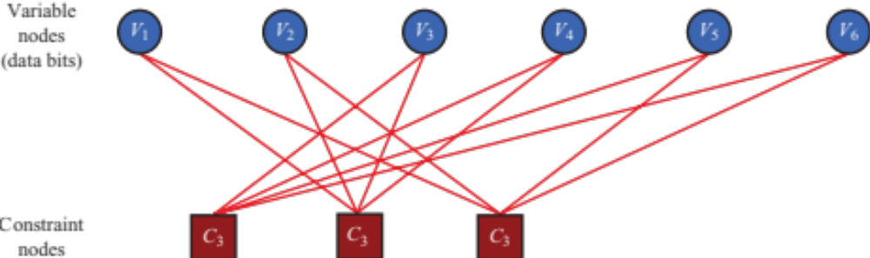
5.17 Tanner Graph for LDPC Iterative Decoding

Slide 81
Convolutional Codes
Generates redundant bits continuously
Error checking and correcting carried out continuously
  (n, k, K) code
    Input processes k bits at a time
    Output produces n bits for every k input bits
    K = constraint factor
    k and n generally very small
  n-bit output of (n, k, K) code depends on:
    Current block of k input bits
    Previous k-1 blocks of k input bits

Slide 82
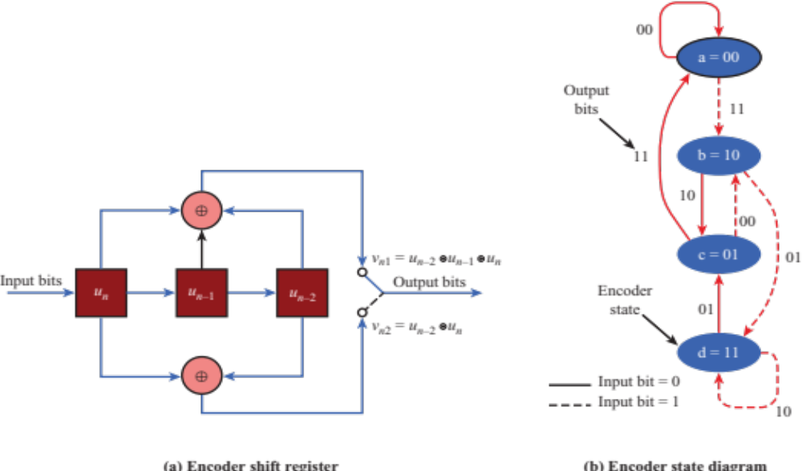
5.18 Convolutional Encoder with (n, k, K) = (2, 1, 3)

Slide 83
Turbo coding
Popular for third- and fourth- generation cellular systems
  Perform very close to Shannon limit
Three versions of the signal are transmitted, interleaved together
  Original signal
  Encoded version of the signal
  Interleaved version that is then encoded
Some of the bits of the interleaved stream are removed

Slide 84
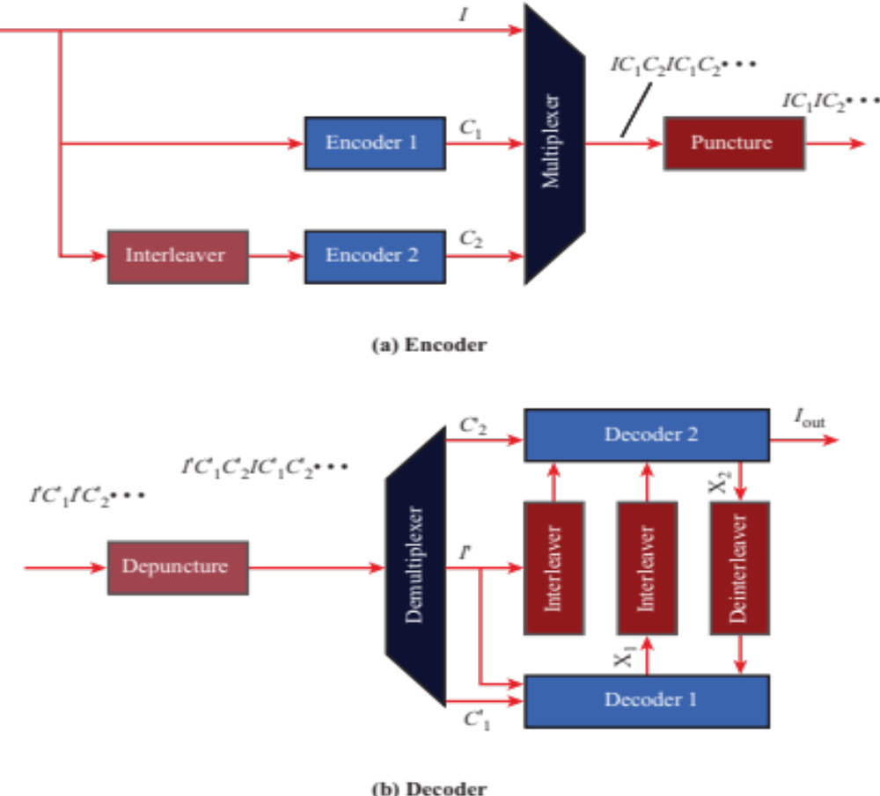
5.19 Turbo Encoding and Decoding

Slide 85
Turbo coding
Decoder
  Missing bits are replaced by estimates or set to zero
  Decoder 1 estimates output bits
    Using two of the streams
    Keeps soft decision information – levels of confidence about decoding
  Decoder 2 estimates output
    Using another set of two data streams and soft decision values from Decoder 1
  Results are fed back to Decoder 1
  Multiple iterations between Decoder 1 and Decoder 2 can occur until a result of high enough confidence results

Slide 86
Automatic Repeat Request
Mechanism used in data link control and transport protocols
Relies on use of an error detection code (such as CRC)
Flow Control
Error Control

Slide 87
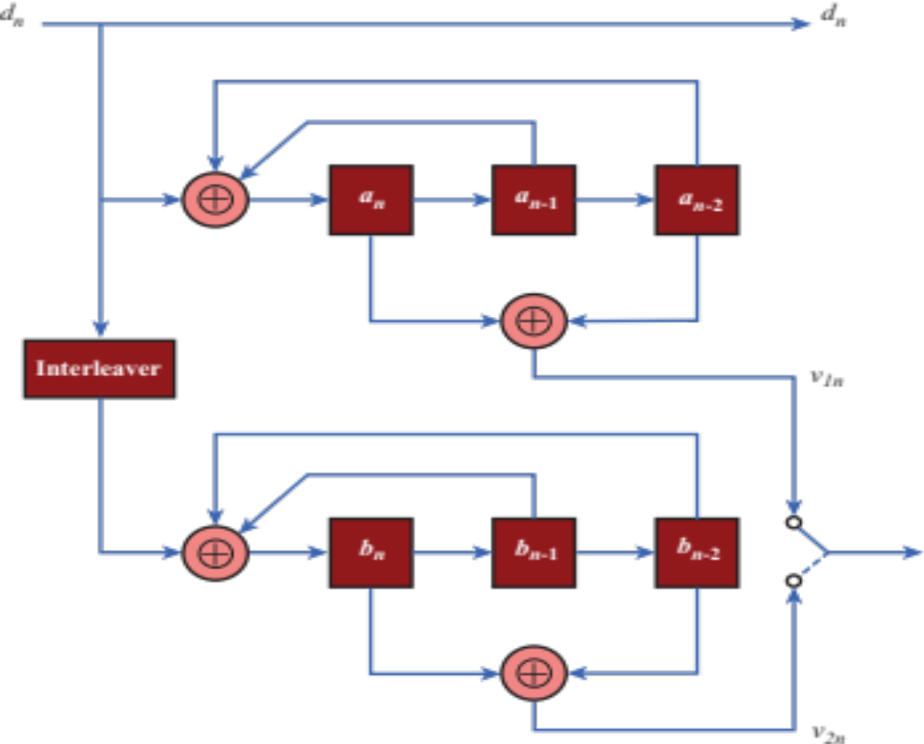
Figure 5.20 Parallel Concatenation of Two RSC Encoders

Slide 88
Error Control
Mechanisms to detect and correct transmission errors
Types of errors:
  Lost PDU : a PDU fails to arrive
  Damaged PDU : PDU arrives with errors

Slide 89

5.21 Model of PDU Transmission

Slide 90
Go-back-N ARQ
Acknowledgments
  RR = receive ready (no errors occur)
  REJ = reject (error detected)
Contingencies
  Damaged PDU
  Damaged RR
  Damaged REJ

Slide 91

5.22 Go-back-N ARQ

Slide 92
HYBRID ARQ
Hybrid Automatic Repeat Request (HARQ)
  Neither FEC or ARQ is adequate in practical situations
    FEC may add unnecessary redundancy
    ARQ may cause excessive delays from retransmissions
  HARQ is widely used
  Uses combination of FEC and ARQ

Slide 93
Hybrid ARQ
Additional HARQ approaches
  Soft decision decoding
  Chase combining
    Soft decision information from a previous frame not corrected by FEC is used with retransmissions
    Chase combining uses exact same frames retransmitted each time
  Incremental redundancy
    Different, maybe more, coding used each retransmission
    Uses less overhead for the first transmissions
    Provides stronger correction

Slide 94
Hybrid ARQ
Additional approaches
  Puncturing
    Remove bits to decrease the coding rate, say from 1/2 to 1/3
    Replace bits at the receiver with random values
    Result may still be effective enough to correct errors
    Allows easier adaptation of coding rates
  Channel quality information will be used to find the best adaptive modulation and coding for HARQ
  Parallel HARQ processes can proceed while others are waiting for retransmissions

Slide 95
orthogonal frequency division multiplexing (ofdm)
OFDM created great expansion in wireless networks
  Greater efficiency in bps/Hz
Main air interface in the change from 3G to 4G
  Also expanded 802.11 rates
Critical technology for broadband wireless access
  WiMAX

Slide 96
How OFDM works
Also called multicarrier modulation
Start with a data stream of R bps
  Could be sent with bandwidth Nf_{b}
  With bit duration 1/R
OFDM splits into N parallel data streams
  Called subcarriers
  Each with bandwidth f_{b}
  And data rate R/N (bit time N/R)

Slide 97

Figure 5.23 Conceptual Understanding of Orthogonal Frequency Division Multiplexing

Slide 98
Orthogonality
The spacing of the f_{b} frequencies allows tight packing of signals
  Actually with overlap between the signals
  Signals at spacing of f_{b} ,2f_{b}, 3f_{b} ,etc.
The choice of f_{b} is related to the bit rate to make the signals orthogonal
Traditional FDM makes signals completely avoid frequency overlap
  OFDM allows overlap which greatly increases capacity

Slide 99

Figure 5.24 Illustration of Orthogonality of OFDM

Slide 100
Benefits of OFDM
Frequency selective fading only affects some subcarriers
More importantly, OFDM overcomes intersymbol interference (ISI)
  ISI is a caused by multipath signals arriving in later bits
  OFDM bit times are much, much longer (by a factor of N)
    ISI is dramatically reduced
  OFDM’s long bit times eliminate most of the ISI
  OFDM also uses a cyclic prefix (CP) to overcome the residual ISI
    Adds additional time to the OFDM symbol before the real data is sent
    Called the guard interval
    ISI diminishes before the data starts

Slide 101
OFDM Implementation
Inverse Fast Fourier Transform (IFFT)
  The OFDM concept (Figure 8.1) would use N oscillators for N different subcarrier frequencies
    Expensive for transmitter and receiver
  Discrete Fourier Transform (DFT) processes digital signals
    If N is a power of two, the computational speed dramatically improves by using the fast version of the DFT (FFT).
    OFDM uses the Inverse FFT to compute the data stream to be transmitted
    Then it is sent on the carrier using only one oscillator

Slide 102

Figure 5.25 IFFT Implementation of OFDM

Slide 103
OFDMA
Orthogonal Frequency Division Multiple Access (OFDMA) uses OFDM to share the wireless channel
  Different users can have different slices of time and different groups of subcarriers
  Subcarriers are allocated in groups
    Called subchannels or resource blocks
    Too much computation to allocate every subcarrier separately
Single-carrier FDMA (SC-FDMA)
  Similar structure and performance to OFDMA
  Lower peak to average power ratio than OFMDA
  Mobile user benefits – battery life, power efficiency, lower cost
    Good for uplinks
  Multiple access is not possible
    At one time, all subcarriers must be dedicated to one user

Slide 104

Figure 5.26 OFDM and OFDMA

Slide 105
Opportunistic scheduling
Schedule subchannels and power levels based on
  Channel conditions
  Data requirements
Adjust in a dynamic fashion
  Use channel variations as an opportunity to schedule the best choice in users
    Hence the term opportunistic scheduling
  Criteria (maybe more than one used simultaneously)
    System efficiency – pick users with best throughput
    Fairness – proportional fairness considers the ratio of users’ current rates to the users’ average rates to know when a channel is best for them
    Requirements – audio, video
    Priority – public safety, emergency, or priority customers

Slide 106
Spread Spectrum
Input is fed into a channel encoder
  Produces analog signal with narrow bandwidth
Signal is further modulated using sequence of digits
  Spreading code or spreading sequence
  Generated by pseudonoise, or pseudo-random number generator
Effect of modulation is to increase bandwidth of signal to be transmitted

Slide 107

5.27 General Model of Spread Spectrum Digital Communication System

Slide 108
Spread Spectrum
On receiving end, digital sequence is used to demodulate the spread spectrum signal
Signal is fed into a channel decoder to recover data

Slide 109
Frequency Hoping Spread Spectrum (FHSS)
Signal is broadcast over seemingly random series of radio frequencies
  A number of channels allocated for the FH signal
  Width of each channel corresponds to bandwidth of input signal
Signal hops from frequency to frequency at fixed intervals
  Transmitter operates in one channel at a time
  Bits are transmitted using some encoding scheme
  At each successive interval, a new carrier frequency is selected

Slide 110

5.28 Frequency Hopping Example

Slide 111

5.29 Frequency Hopping Spread Spectrum System

Slide 112
Direct Sequence Spread Spectrum (DSSS)
Each bit in original signal is represented by multiple bits in the transmitted signal
Spreading code spreads signal across a wider frequency band
  Spread is in direct proportion to number of bits used
One technique combines digital information stream with the spreading code bit stream using exclusive-OR (Figure 5.30)

Slide 113

5.30 Example of Direct Sequence Spread Spectrum

Slide 114

5.31 Direct Sequence Spread Spectrum System

Slide 115

5.32 Approximate Spectrum of Direct Sequence Spread Spectrum Signal

Slide 116
Code-Division Multiple Access (CDMA)
Basic Principles of CDMA
  D = rate of data signal
  Break each bit into k chips
    Chips are a user-specific fixed pattern
  Chip data rate of new channel = kD
Each user encodes with a different spreading code

